Slide 1
Intro. To Static Analysis
C.K. Chen
2014.09.23

Slide 2
Outline
Intro. To Static Analysis
Common Tools inLinux for Static Analysis
Disassemble
Reverse Assambly to C
Fundamental ASM
IDA Pro
Pracetice
Tips for Static Analtsis

Slide 3
Intr. to Static Analysis
Static analysis
Analysis malware without execution
Dynamic analysis
Execute malware inside controllable environment and monitor it’s behavior

Slide 4
Information from Static Analysis
What information we can get from static analysis

Slide 5
Information from Static Analysis
What information we can get from static analysis
File Structure
Binary Code
Related Module
Suspicious String

Slide 6
Information from Static Analysis
What we cannot get?
Register Value
Memory Value
Packed Code
Encrypted Message

Slide 7
Usage of static analysis
In normal case, there are some problem that static analysis is involved
Reverse: Windows, Linux
Pwned(Exploit): Linux, Windows(rare)
Complement to the dynamic analysis

Slide 8
First step to Static Analysis
There are some Linux command that can give use information of file
Strings
Objdump
Hexdump
File

Slide 9
Linux Command
Strings
For each file given, GNU strings prints the printable character sequences that are at least 4 characters long and are followed by an unprintable character.
Get clues of file

Slide 10
Linux Command
File
File tests each argument in an attempt to classify it. There are three sets of tests, performed in this order: filesystem tests, magic number tests, and language tests. The first test that succeeds causes the file type to be printed.

Slide 11
Linux Command
Hexdump
The hexdump utility is a filter which displays the specified files, or the standard input, if no files are specified, in a user specified format.
Hex, Oct, Char, …..

Slide 12
Linux Command
ldd - print shared library dependencies
Loading library
Location of library file
Loading address of library

Slide 13
Linux Command
Objdump
Dump information of ELF file
Rice information can be dumped
Can used to build simplest malware analysis system

Slide 14
Objdump

Slide 15
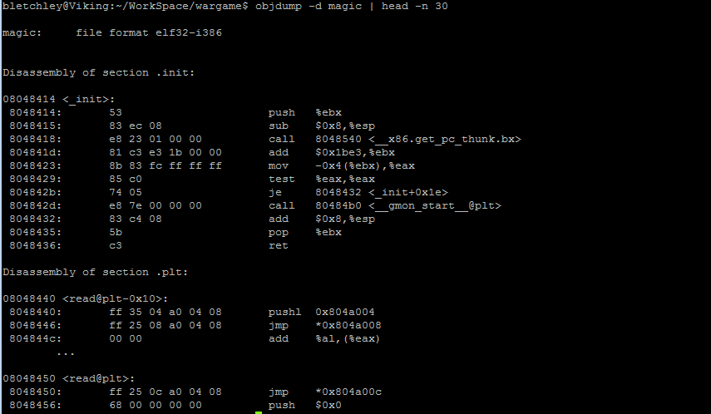
Disassemble
objdump -D

Slide 16
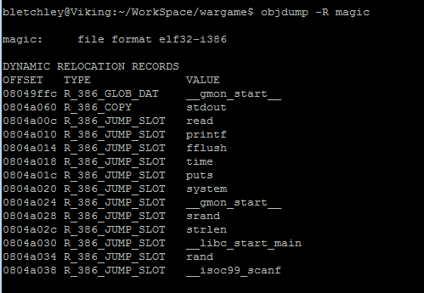
Global Offset Table
objdump –R
Key of sharing library in linux
GOT Hijack

Slide 17
Disassemble
Disassemble is a procedure to covert binary machine code into assembly code

Slide 18
Information inside Disassemble
Instruction used in executable
Data used in executable

Slide 19
Code Discovery Problem
In the binary file, instructions and data may hybrid in the section.
It is not easy to discover instructions in the binary
Especial for variable-length instruction set like x86

Slide 20
Linear sweep
Starts usually to disassemble from the first byte of the code section in a linear fashion
Disassembles one instruction after another until the end of the section is reached
Do not understand program flow
objdump

Slide 21
Recursive traversal
instruction classified as
Sequential flow: pass execution to the next instruction that immediately follows
Conditional branching: if the condition is true the branch is taken and the instruction pointer must change to reflect the target of the branch, otherwise it continues in a linear fashion (jnz, jne, . . . ). In static context this algorithm disassemble both paths
Unconditional branching: the branch is taken without any condition; the algorithm follows the (execution) flow (jmp)
Function call: are like unconditional jumps but they return to the instruction immediately following the call
Return: every instructions which may modify the flow of the program add the target address to a list of deferred disassembly. When a return instruction is reached an address is popped from the list and the algorithm continues from there (recursive algorithm).
Some issue
Indirect code invocations
Does returning from a call always allow for a faithful disassembly

Slide 22
Problem of Disassembly
Remember that disassembler may not always true
Linear sweep
Recursive traversal
jmp .destination
db 0x6a ; garbage byte technique
.destination:
pop eax
eb 01 jmp 0x401003
6a 58 push 0x58
push DWORD .destination
jmp DWORD [esp]
db 0x6a ; garbage byte technique
.destination:
pop eax
push DWORD .destination
jmp DWORD [esp]
push 0x58

Slide 23
Reverse Assambly to C
Registers Architecture
The EIP register contains the address of the next instruction to be executed if no branching is done.

Slide 24
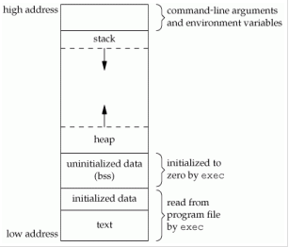
Memory Layout
Stack
Not maintain in Executable
Local Variable
Heap
Not maintain in Executable
Dynamic Allocate Memory
BSS Section
Uninitialized Data
Global variables and static variables that are initialized to zero or do not have explicit initialization in source code
Data Section
Initialized Data
Global variables and static variables

Slide 25
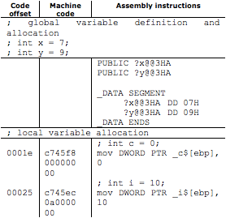
Variables
Disassembled code for local and global variables

Slide 26
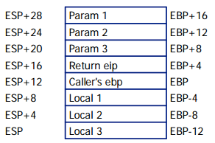
Local Variables/Arguments
Caller push argument into stack
Caller push eip by call instruction
Callee save/push the caller’s ebp
Callee reserve space for local variables
sub
Stack Growing Direction

Slide 27
Data Movement
MOV dst, src
Src <= dst
LEA dst, src
Load effective address of operand into specified register
To calculate the address of a variable which doesn't have a fixed address
Example
mov eax, [ebp - 4] <= get content in [ebp - 4]
mov eax, ebp – 4 <= wrong, no such instruction
lea eax, [ebp - 4] <= get address of [ebp - 4]

Slide 28
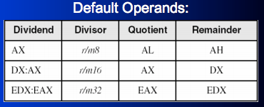
Arithmetic Operator
add dest, src
sub dest, src
mul arg
div
DIV r/m8
DIV r/m16
DIV r/m32
inc
dec

Slide 29
Control Instructions
Flag, each instruction updates some field of flag for future branch
test
Performs a bit-wise logical AND
sets the ZF(zero), SF(sign) and PF(parity) flags
cmp
Performs a comparison operation between arg1 and arg2
Set SF, ZF, PF, CF, OF and AF

Slide 30
Branch Instruction
JE Jump if Equal ZF=1
JNE Jump if Not Equal ZF=0
JG Jump if Greater (ZF=0) AND (SF=OF)
JGE Jump if Greater or Equal SF=OF
JL Jump if Less SF≠OF
JLE Jump if Less or Equal (ZF=1) OR (SF≠OF)

Slide 31
Stack Operation
Stack is the LIFO data structure
PUSH: put data into top of stack
POP: get data from top of stack

Slide 32
Function Call
Call
Similar to jmp, but a CALL stores the current EIP on the stack
RET
Load the address in esp, and jump to that address
RET num
Increase esp by num
Load the address in esp, and jump to that address

Slide 33
Function Pro
Function Prologue
Store current EBP
Save ESP to current EBP
Leave space for local variables
Function Epilogue
Set ESP to EBP
Restore EBP

Slide 34
Calling Convension
The transition of function arguments must be maintain by assembly programmer, but most case maintain by compiler
Stdcall
function arguments are passed from right to left
the calleé is in charge of cleaning up the stack.
Return values are stored in EAX.
cdecl
The cdecl (short for c declaration) is a calling convention that originates from the C programming language and is used by many C compilers for the x86 architecture.
The main difference of cdecl and stdcall is that in a cdecl, the caller, not the calleé, is responsible for cleaning up the stack.
pascal
The pascal calling convention origins from the Pascal programming language
The main difference between it and stdcall is that the parameters are pushed to the stack from left to right.
fastcall
The fastcall is a non-standardized calling convention.
the fastcall convention tends to load them into registers. This results in less memory interaction and increases the performance of a call.

Slide 35
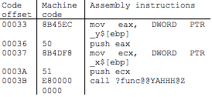
Function Call Structure
Function Call Structure

Slide 36
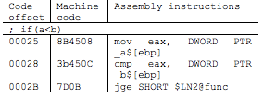
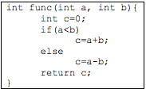
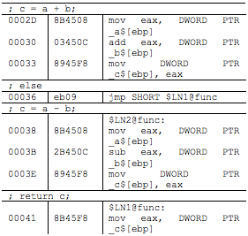
Branch Structure
Branch Structure

Slide 37
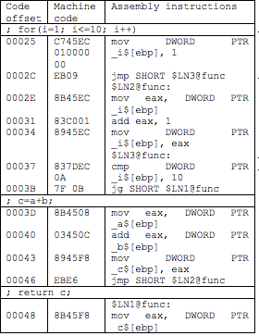
Do-For loop
Do-For loop

Slide 38
IDA Pro
IDA Pro is the most well-known dissemble/decompile tool for reversing
Disassemble
Friendly GUI
Decopiler
Debugger

Slide 39
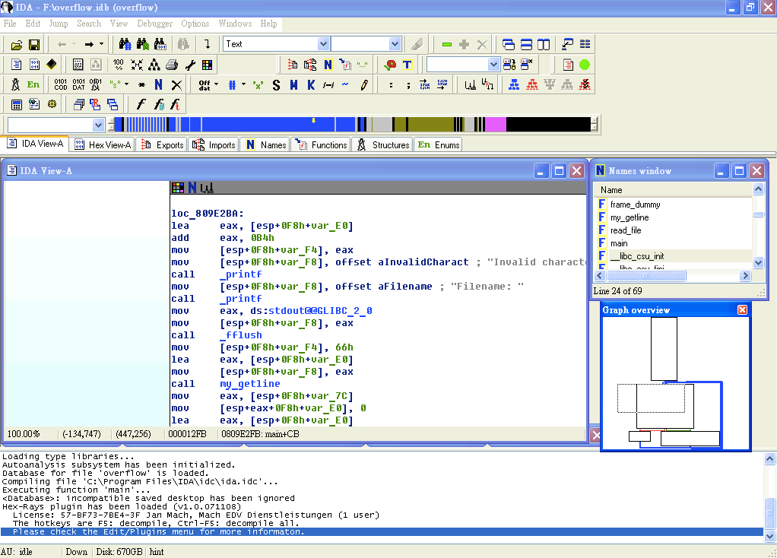
Overview
Assembly and Control Flow View
Control Flow View
Message View

Slide 40
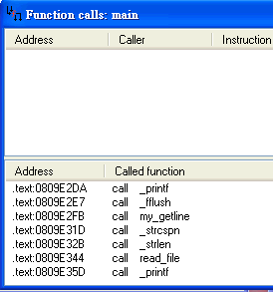
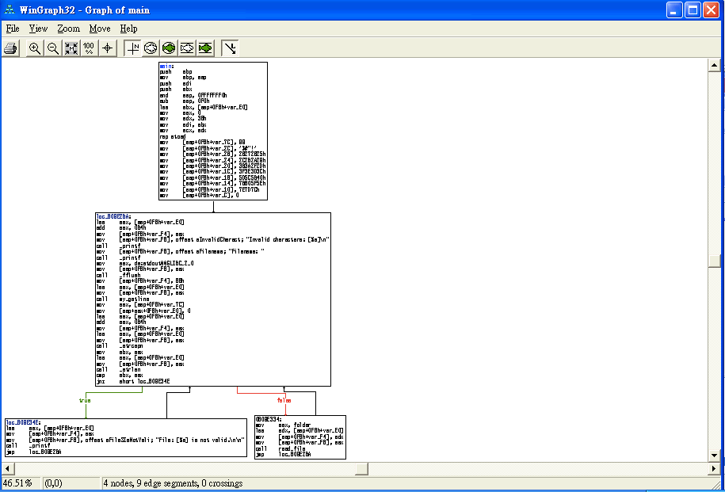
Functionality(1)
Fun Call Window
Graph
Convert Current Location
DATA
Instruction
String
Self-defined Data Structure
Array
Convert Oprand
Offset
Hex/Oct/Dec/Bin
Constant Char
Segment-based Var
Stack-based Var
….
Xref Table
Once The disassemble make mistake, you can fix it yourself

Slide 41
Functionality(2)
Export Function
List functions export to other Binary
DLL, entry point
Import Function
Functions included from other files
Import function can help you to guess the behavior of program
Names
Function Name
Variable Names
Strings
For problem with debugger information inside, names can be useful
Strings
All strings use
For some easy problem, this can help you to get flag
For other problem, it still give you quick look to program

Slide 42
Useful Hotkeys
List of useful hotkeys
 | Function | Hotkey
1 | Strings | Shift+F12
2 | Jump to operand | Enter
3 | Jump to previous position | ESC
4 | Jump to next position | Ctrl+Enter
5 | Jump to address | G
6 | Jump to entry point | Ctrl+E
7 | Sequence of bytes | Alt+B

Slide 43
Practice
Reverse encryption algo in bot.exe

Slide 44
Decompiler
Decompiler can help you to transfer assembly into C code
More easy to read

Slide 45
But
Decompiler result is not perfect
Most of time is buggy
Lack of source code level information
May not support All platform
Arm
X86
X64
…..

Slide 46
Reversing Concept
Identify important part of program
Backward tracking user data
Forward tracking interesting API function
Convert back to C code

Slide 47
Identify important part of program
Identify what you interesting
Strings: ‘flag’, ‘key’, ….
Function to read input: scanf(), gets(),…
Function for network communication: recv(), send()
Read/Write file
…..

Slide 48
Backward tracking user data
Most program vulns must be trigger by user input
You can not(or difficult) to attack a function independent to your input
Keep track about variables affect by your input
Data Propagate
Data Dependency

Slide 49
Forward tracking interesting API function
Most vuln are cause by some certain functions
strcpy()
memcpy()
scanf()
printf()
strcat()
…..
Try to trigger these functions
Analysis control flow and make strategy to enforce program goto these functions

Slide 50
Convert back to C code
Gather information
IAT
strings
dynamic analysis
Identify function of interest
Identify CALLs
Identify algorithms and data structures
Pseudo-code it!
Rename function(s), argument(s), variable(s)

Slide 51
Problem of static analysis
Encryption/Self Modified Code
Lack of runtime information
Take a lot of time to understand program ☹

Slide 52
Advantage
Why we still needed static analysis?
Give you very first concept of program
Overview of program flow
Hybrid with dynamic analysis

Slide 53
Summary
This course bring the basic idea of static analysis
Intro. some tool for static analysis
Basic ASM
How to reverse asm to c
Function call
Memory
Some tips for static analysis

Slide 54
Q&A

