Slide 1
From CTF rookie to DEFCON participant
ddaa

Slide 2
Who am I
ddaa, ddaa, 0xddaa
Start to play CTF since last year
One of the members in HITCON CTF team

Slide 3
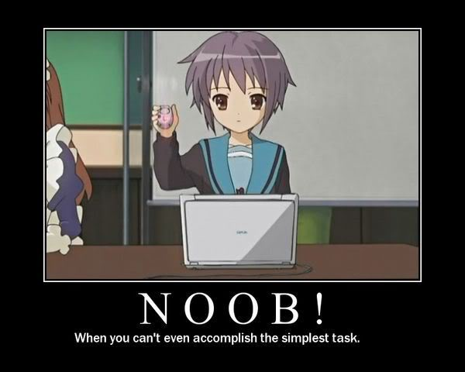
Ability (before Mar 2013)
Only C and java
for homework
Basic knowledge in SA
Use FreeBSD about two years
Good grade in study
Participated HITCON in 2011
Only got 200 points…
That’s all

Slide 4
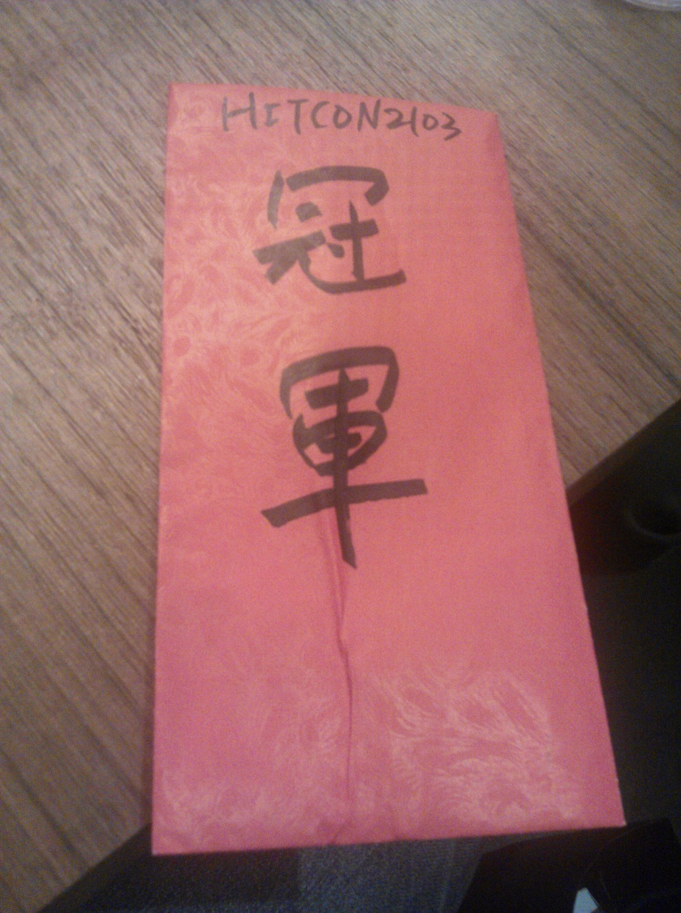
Inchoation
Secure Programming spring 2012
http://wargame.cs.nctu.edu.tw
Sooooooooooooo difficult (but in fact, it’s easy)
Spent about a week for homework 3 and 4
HITCON 2013
I didn’t solve any problem……
But our team are champion!
CSAW 2013
My first CTF :p

Slide 5
Accumulation
Select a problem which you want to solve (or you can solve).
If you have no idea for any problem, you should survey some information or background.
Think a method to solve the problem.
Discuss with somebody, but don’t ask the solution directly.
If it’s work, congrats! :D
Write down your solution after CTF and share to everyone.
Otherwise, try another method.
It may take several hours, even days……
If you can’t solve the problem in the end, find the write up of the problem.

Slide 6
Before solving the problem…

Slide 7
After solving the problem…

Slide 8
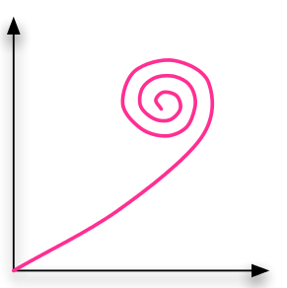
What you need
interest
patience
an appetite for knowledge
programing, reverse, cryptography,
algorithm, stenography, forensic
information security, … , etc.

Slide 9
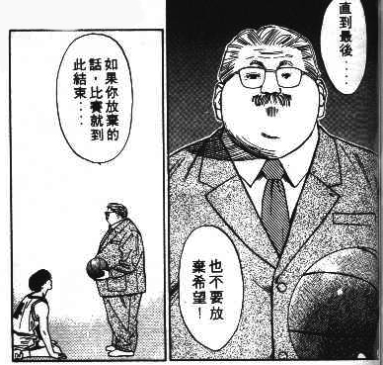
The most important……
Never give up!!!

